Slide 1








Sport Hazing - Awareness & Action
Dr. John Heil
Notes:
This PowerPoint is a component of a comprehensive training program in Sport Hazing, which includes instructional videos, handouts for a general audience (Athletes, Coaches, Parents & Administrators etc.) and scholarly content on Theory & Practice.
The entire program is free to any user for any educational purpose, including community presentations and professional training.
While this program is focused specifically on hazing, many of the same underlying dynamics are found in bullying, sexual harassment and other forms of interpersonal violence within a team or organization. Occasional references to this broader context are found throughout the training program.
Information supporting the content of this PowerPoint including references, are available in the scholarly paper, “Sport Advocacy: Challenge, Controversy, Ethics & Action” which can be found at the “Theory & Practice” button.

Slide 2
Summary
        About Hazing
        The “Why” of the Dark Side
        Barriers to Change
        Remedies – Training, Legal, Organizational
        When Organizations Fail
        Team Building & Hazing
        Taking Action – for Stakeholders
        Sport’s END Game
Notes:
Those who elect to make a presentation are encouraged to draw on their unique knowledge and experience.
Presenters should feel free to modify or revise this PowerPoint to whatever extent deemed necessary to meet their particular objectives.
We request that the individual slides be preserved intact, and that APA and other branding be maintained, whenever possible. If the user feels more extensive revisions are needed, we then ask that the program be recognized by inclusion of the introductory slide and by listing the website where the PowerPoint and related program materials are archived.

Slide 3

Hazing
“Any activity expected of someone joining or participating in a group that humiliates, degrades, abuses, or endangers them regardless of a person’s willingness to participate.”
Like forced alcohol consumption, physical brutality, forced exclusion, property damage…
Notes:
Hazing is complex and difficult to define precisely, especially as an operational concept - that is in terms of describing whether a particular behavior is hazing or not. The definition provided offers a starting point.
The concept will be developed in more depth as the presentation unfolds.

Slide 4
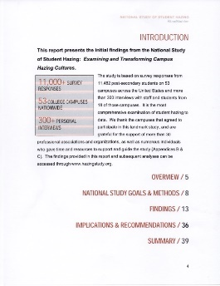
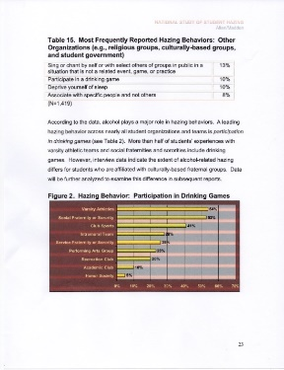
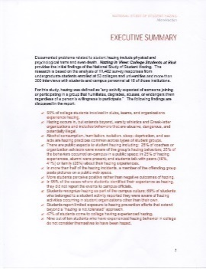


University of Maine Study
55%-Sport Teams & Org’s
25% Coaches Aware
25% Campus - Public Space
25% Alumni Present
>50% Pictures on a public web space.
Phase 1 – 100 Q Survey
11,000 students
53 colleges
Phase 2 – Interviews
350 School Reps
18 Colleges
Allan, E., J., & Madden, M. (2008, March11). Hazing in view: College students at risk: Initial findings from the national study of student hazing. University of Maine
Notes:
The University of Maine study is the most comprehensive and in-depth investigation of hazing practices in higher education, surveying 11,482 undergraduate students enrolled at 53 colleges and universities.
It includes fraternities and sororities, sports teams and other campus organizations. It revealed that hazing is widespread and that a gap exists between student experiences of hazing and their willingness to label it as such.

Slide 5

Florida A&M Marching Band
Man Convicted in Hazing Death of Florida A&M Band Member 2014/2011
Vaunted Marching Band
“Crossing Bus C”
Robert Champion was beaten to death with drumsticks, mallets and other items during an established hazing ritual
Notes:
The death of Robert Champion is the worst-case scenario of the unwanted, unintended consequences of hazing. It exemplifies how established “traditions” can derail, and demonstrates the false sense of safety that comes when a practice has been done many times before – despite the apparent risk.
However, catastrophic outcomes are a predictable consequence of repeated risky behaviors which continue over time without adequate checks and balances.
Condolences to who have lost someone to hazing.

Slide 6


Sayerville HS – New Jersey
How New Jersey Football Hazing Scandal Points To Deeper “Rape Culture”
  Seniors on the team would routinely turn off the lights, pin down a freshman, and then haze him by violating him with a finger
  Student Comment: “It happens at all the schools”
Notes:
The unapologetic response from some involved in this incident and the implication that it is acceptable because others do it is puzzling.
The collective acceptance of criminal sexual assault in a sport setting raises an array of questions: Does sport operate by a different standard from the rest of society? How are such practices maintained over time given their destructive impact? How can a practice like this escape detection by those responsible for the team?

Slide 7

Jonathan Martin – NFL Miami Dolphins
Hazing Tips to Bullying
“Your job leads you to attempt to kill yourself …”
“Your self-perceived social inadequacy dominates your every waking moment and thought…”
“You let your demons go, knowing that, perhaps, sharing your story can help some other chubby, goofy, socially-isolated, sensitive kid getting bullied in America”
Martin's rookie season...
Incognito, Jerry and Pouncey began regularly calling Martin a "c###," a "bitch," a "pussy" and a "faggot."
Notes:
The imposing physical presence of College All-American and NFL lineman Jonathan Martin, and the extreme and enduring impact of his hazing experience reveals that all are psychologically vulnerable.
When hostilities persist in a team environment hazing tips into bullying – exemplifying the “slippery slope” of hazing.

Slide 8

Psychology of Hazing
Essential
Human Needs:
Belonging & Esteem
Innocent
Unintended Consequences
Discounting Bad Outcomes
Sinister
Social Conformity
Obedience to Authority
Notes:
There is a broad array of factors that drive hazing, spanning the Essential, the Innocent and the Sinister -- providing insight into why hazing exists and why it persists despite efforts to prevent it.

Slide 9
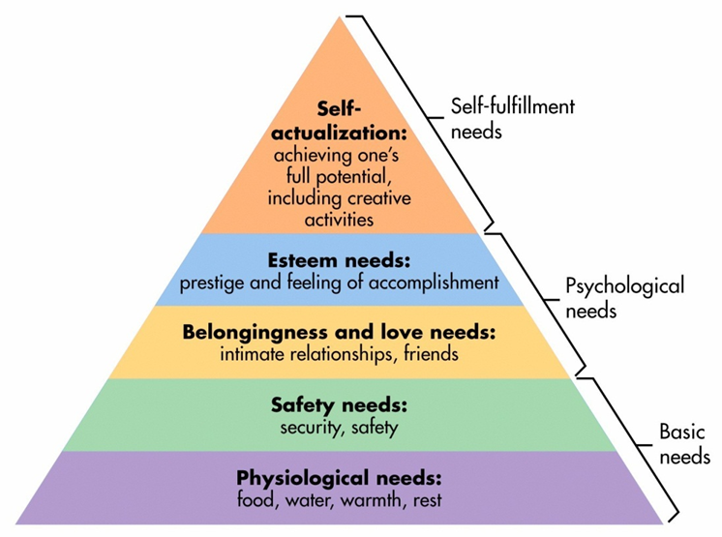
ESSENTIAL: Belonging
Maslow’s Hierarchy
Hazing is driven by needs for
Belonging & Esteem
Hazing jeopardizes
Safety & Physiological Needs
Sport at Best fulfills
Self-Actualization Needs
Notes:
Abraham Maslow is a pioneer in positive psychology. His work, the “Farther Reaches of Human Nature” provides insight into the forces that make us human and drive behavior ranging from survival to socialization to self-actualization.
The fundamental need for belonginess is at the core of why hazing is tolerated, even as it may jeopardize safety and physiological needs.
Maslow’s message of self-actualization speaks to the widely held belief that sport can be a path to personal development, and offers an ideal model of what sport can be.

Slide 10

INNOCENT: Unintended Consequences
CALCULATING RISK
1 Accidental Death occurs for every 100 disabling injuries
1 Disabling Injury for each 29 accidental injuries
1 Accidental Injury for each 300 unsafe acts
Ryan, A. J. (1973). Medical practices in sports. Law and Contemporary Problems
Notes:
There is a false sense of safety that comes when practices go on, year after year, without adverse consequences.
However, the numbers tell the story of what is inevitable given repeated risky behaviors over time. This calculus of risk points to the inevitability of fatality as reflected tragically in death of Robert Champion.
According to a hazing clearinghouse established by Hank Nuwer, there has been at least one hazing death on a college campus every year since at least 1959.

Slide 11


SINISTER: Dark Side
Slippery Slope
Historical Lessons
                “Lynch Mobs - Holocaust”
                Murder of Kitty Genovese
  Contemporary Research
  Milgram Obedience Study (1965)
  Zimbardo Prison Study (1971)
Notes:
There are some behaviors, such as racial lynching in the USA and the holocaust in Germany, that are so extreme that they are indefensible in the face of rational scrutiny. Yet nonetheless, history teaches us that these behaviors do occur across time and circumstances, suggesting a dark side to human behavior.
The question of how otherwise reasonable people may slip into such extremes has caught the attention of social psychologists, whose groundbreaking research is presented.
In a poignant twist, the adverse impact on the participants in these classic experiments was found to be so disruptive, that such studies are now deemed unethical. Their lessons persist as a cautionary tale.

Slide 12
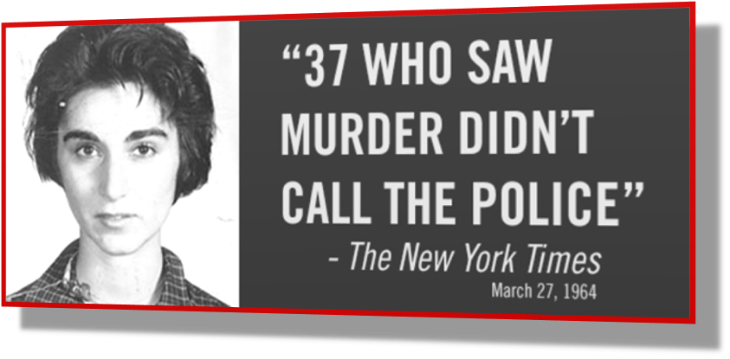

Murder of Kitty Genovese
Diffusion of Responsibility
Bystanders: “Someone Else Would Step-up”
Murderer Report:
“I knew no one would respond”
Notes:
The murder of Kitty Genovese in 1964 shocked the consciousness of the times. That no one called the police for assistance despite the prolonged and public nature of her assault and death led to a collective soul searching that spanned public and professionals alike.
The “Good Samaritan” research by psychologists Darley and Batson explains this as a diffusion of responsibility, which in turn has given rise to more enduring questions regarding our accountability as citizens, neighbors and teammates.

Slide 13
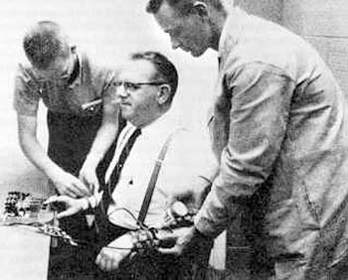

Milgram Obedience Studies
“Learning Study” @ Yale University
2/3 of Subjects
Shock “Learner” into Unconsciousness
Many continued to deliver shock despite screams of subject
No actual shocks were delivered
Notes:
In the “obedience studies” conducted by Stanley Milgram electric shock is presumably (but not actually) delivered to subjects under the pretense of a study on learning. In one study approximately 2/3 of subjects shocked “learners” (actually actors) into a presumed state of unconsciousness, despite their vehement vocal protests.
Although no one was actually injured, the impact, in retrospect, on those who believed they were delivering shocks was emotionally disruptive nonetheless.
The story of this research is presented in the 2015 film, the “Experimenter.”

Slide 14

Calculus of Obedience
Increased Shock
  Prestigious Institution
  “Trappings of Legitimacy”
  Noble Purpose
  “Good of Science”
  See Others Do it
  “Normalization of Behavior”
  Decreased Shock
  ‘OK’ from Researcher
  See Others Refuse to Shock
Notes:
Through a series of experiments, Milgram identified specific factors that drive obedient behavior, and those conditions that enable ethical behavior, ranging from the status of a prestigious institution to encouragement from the researcher.
It is noteworthy that those who observed another person refuse to deliver shock, were more likely to refuse to shock also. The compelling question here is “Why do we need permission to do the right thing?“ This also points to the power of one to make a difference.

Slide 15

Stanford Prison Experiment
College Students Randomly Assigned
Role of guard or inmate
2 weeks in a simulated prison
Shut Down After 6 Days
Guard - Brutality
Prisoner – Deterioration
Kafkaesque Reality Shift
Thought of as prison- not experiment
Notes:
A mock prison was created in a dorm basement at Stanford University, with volunteer guards and inmates closely observed by experimenters. This turned out to be uncharted territory for subjects and experimenters alike as the prison environment rapidly deteriorated. The transformation was so extreme that it has been compared to Franz Kafka’s classic work the “Metamorphosis.”
This story is told in the 2015 film, “The Stanford Prison Experiment.”

Slide 16

Compliance Or Challenge
DARK SIDE
~50 Observers “Adapted to Scripted Role”
Parents – Visiting Privileges
Clergy – Pastoral Visit
Experimenters including Zimbardo
Bright Side
The Power of One to Make a Change
Dr. Christina Maslach
“It's terrible what you are doing to these boys!”
Study Ends Abruptly
Notes:
In a situation reminiscent of the Kitty Genovese murder, not even the family visitors or experimenters stepped forward to call a halt as the situation obviously deteriorated.
Then in a compelling demonstration of the ability of one to make a difference, consultant, Dr. Christina Maslach brought an end to the study. This demonstration of the “power of one” to make a difference is also reflected in the Milgram study.

Slide 17

Barriers to Change
Convincing Rationale
Assumption of Consent
Diffusion of Responsibility
Whistleblower Effect
Victim Effect
Notes:
A series of factors function as barriers to the recognition, reporting and prevention of hazing. These are driven by a diverse array of psychological dynamics and reinforced in the sport setting by subtle cultural messaging.

Slide 18
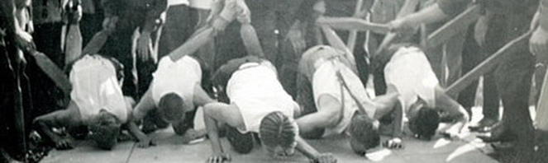
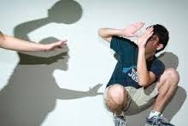
Convincing Rationale?
Diffusion of Responsibility
“Team Activity”
Displaced Responsibility
“Tradition”
Underestimate Risk
“No One Really Hurt”
Attribution of Blame
“She Agreed”
Notes:
The widespread acceptance of hazing rests on a series of somewhat convincing rationales which justify behaviors. These explanations function in a manner similar to those used by experimenters in the Milgram Obedience studies.
However, as in the Milgram studies, these are very easily debunked when subjected to rational scrutiny.

Slide 19
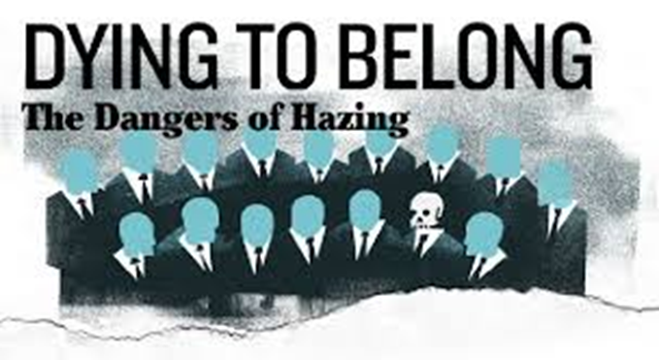
Assumption of Consent
Can Victims Give “Consent”?
Silence, Resignation & Perpetuation of Hazing
or
Speak Out & Risk Exclusion
Double Bind
“Lose-Lose” Situation
Illusion of Choice
Notes:
There is a widespread assumption that the subjects of hazing routinely give consent, although true consent is not possible. The choices to either resist and risk exclusion, or accept things in silence poses a dilemma – a situation in which neither choice offers a positive outcome.
This type of “lose-lose” situation has been described as a double bind.

Slide 20

Laing - on the Double Bind
“They are playing a game… They are playing at playing a game…
If I show them I see they are, I shall break the rules and they will punish me.
I must play their game, of not seeing I see their game.”
Notes:
The concept of the double bind resists simple description. The concept of the double bind is reflected in the title of Joseph Heller’s novel (and film by the same name), “Catch 22.”
The words of psychiatrist and poet, R. D. Laing capture its subtlety.

Slide 21

Diffusion of Responsibility
Almost 80% say hazing bothers them …
Only 20% say they try to stop it…
Students recognize hazing as part of campus culture
University of Maine Study
Notes:
That diffusion of responsibility is at work in hazing is reflected in the findings of the University of Maine study. Failure to report incidents and to seek change is influenced by the normalization of hazing in campus culture.

Slide 22

Whistleblowers
Must overcome concerns that they will face retaliation or that the risks they take will be in vain…especially when their information proves significant
Pope (2015)
95% of the cases where students identified their experience as hazing they did not report the events to campus officials
University of Maine study
Notes:
Whistleblowers across all levels of society risk retaliation when speaking out. The more offensive the behavior, the greater the ethical imperative to report and the greater the potential negative consequences for doing so – and the greater the bind faced by the whistleblower.

Slide 23

Whistleblower & Victim
When Acting on Own Behalf?
Jeopardy re: Team Status
&
Shame re: Disclosure
Double Bind
Illusion of Choice
“Lose-Lose” Situation
Notes:
The whistleblower who is also a victim faces the double bind of accepting the events or reporting them. However, in a team environment, the stakes escalate, as the player not only jeopardizes team status but also faces the shame of disclosure. The combination of shame from disclosure and punishing consequences for seeking a remedy is the prototypical dilemma faced by the sexual assault survivor.
This whistleblower-victim dilemma offers insight into why Bart Starr, NFL Hall of Fame player from the Lombardi era Green Bay Packers remained silent about his college hazing. After a lifetime of carefully crafted public statements, his poignant end-of-life revelation speaks to the power of hazing over its victims and the need for change.

Slide 24
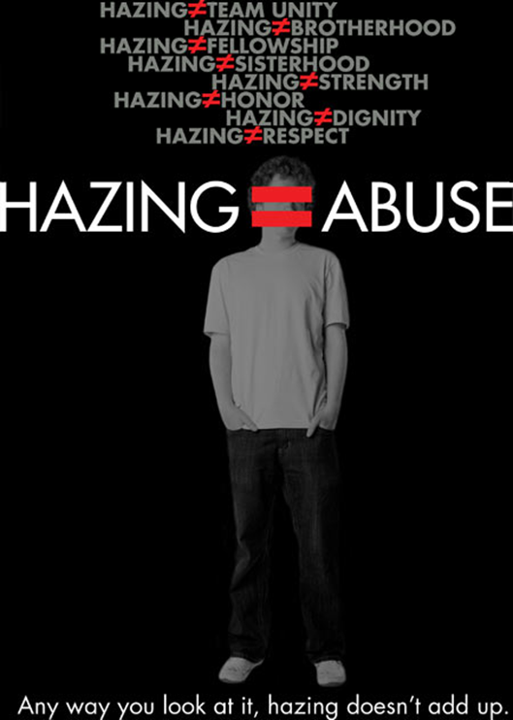
REMEDIES
Education & Training
LAWS
Organizational Response
“The Problem Continues”
Notes:
In recognition of the significant problems posed by hazing and its resistance to remedy, a variety of measures have been taken including educational programming, widespread implementation of legal statutes, and efforts at clarifying accountability by sports organizations. However, this has met with limited success.

Slide 25

Hazing Awareness & Education
e.g., STEP UP! Bystander Intervention Program
Notes:
The STEP UP! Program (whose brochure is displayed) developed at the University of Arizona in partnership with the NCAA, addresses a wide range of concerns facing the college student. The inclusion of a hazing education program within a broadly-based bystander intervention program implicitly addresses the questions of diffusion of responsibility and shared accountability.
While awareness and training are critical to creating change, the impact of programs appears to be limited for reasons which are not fully clear. This is likely due to the complexities of the psychological dynamics that drive hazing, and to the challenge of applying general principles and concepts to specific situations.
.

Slide 26
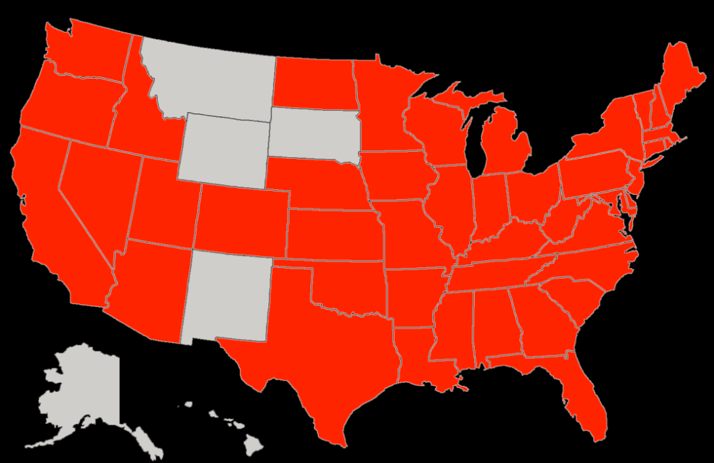
Anti-Hazing Laws
44 States
Notes:
Most states - but not all - have enacted anti-hazing laws. These can vary significantly from state to state.

Slide 27
Pennsylvania Hazing Statute
Any action or situation which recklessly or intentionally endangers the mental or physical health or safety of a student or which willfully destroys or removes public or private property for the purpose of initiation or admission into or affiliation with, or as a condition for continued membership in, any organization operating under the sanction of or recognized as an organization by an institution of higher education. The term shall include, but not be limited to, any brutality of a physical nature, such as whipping, beating, branding, forced calisthenics, exposure to the elements, forced consumption of any food, liquor, drug or other substance, or any other forced physical activity which could adversely affect the physical health and safety of the individual, and shall include any activity which would subject the individual to extreme mental stress, such as sleep deprivation, forced exclusion from social contact, forced conduct which could result in extreme embarrassment, or any other forced activity which could adversely affect the mental health or dignity of the individual, or any willful destruction or removal of public or private property.
Notes:
The Pennsylvania statue is explicit in its definition, listing the prototypical examples of hazing. In other states, what constitutes hazing is much less clearly defined.
It is noteworthy that this statute includes reference to social exclusion, which although easily overlooked is the quintessential element at the core of hazing.
Unfortunately, neither legal statutes nor hazing education nor organizational policies appear to have been a sufficiently effective deterrent.

Slide 28

Organizational Response
  WILD CARD!!
  Accountability & Remedy
  or
  Enabling & Institutional Betrayal
Notes:
Organizations set standards and create culture for its stakeholders. They are the higher authority empowered to monitor and manage behavior, and to enforce corrective actions when necessary.
When organizations accept accountability and seek a remedy, a solution is in the making. In failing to do so, problems are magnified. In the worst-case scenario, the organization may align against the victim in an effort to protect itself from adverse consequences.

Slide 29

Canadian Mandated Sports Policies
66 Provincial & National Sport Organizations
  Absent Policies
Only ~1/3 Have Hazing/Bullying Policies
Reporting Barriers
Only 4 Provide Contact Info For Harassment Officer
From: Donnelly et al, 2014
Notes:
Well-intended mandates for policy implementation can easily fall short. Research by Donnelly and colleagues reveals a mix of failure to comply with the national organization mandate, as well as, poorly constructed policies.
The lack of a clear pathway to file a complaint or to seek a remedy, as reflected in the absence of a contact person is particularly compelling. When the steps to reporting or otherwise seeking a remedy are unclear, efforts to do so are undermined. This plays into the hands of those who would resist accountability.
A proper procedure would identify those at fault and absolve those that are innocent. In so doing, the organization makes a correction, affirms its mission and continues on its true course.
Policies Implemented in a way which inadvertently (or otherwise) undermine the likelihood of finding a solution has been described as an example of an ethics placebos. This will be described in detail subsequently.

Slide 30

The Problem Continues
Need to move beyond a legal compliance mindset and embrace a strong ethical culture
From: NCAA GOALS Survey
Culture Change:
A Role for All Stakeholders
Notes:
Recognizing the limited impact of education, legal statutes, and organizational policy on hazing, the NCAA recommends a deliberate effort at developing a culture that more effectively supports athletes’ health and personal development.
Culture change, as is suggested, demands involvement of all stakeholders at all levels. The work of Maslow offers an aspirational model of what this culture change may be.

Slide 31
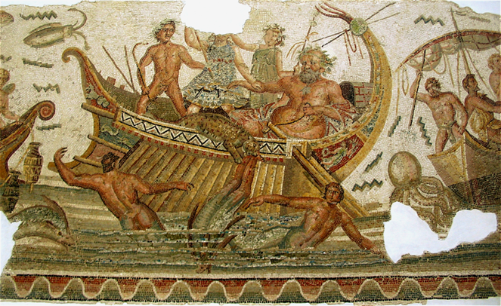
When Organizations Fail
Helm’s Effect
Institutional Betrayal as
Failure of Leadership
Ship Adrift with
Broken Moral Compass
Notes:
All too often organizations fail to hold themselves accountable for hazing and other forms of interpersonal violence. The Penn State sex scandal and the racial discord at the University of Missouri persist as prototypical examples.
These incidents represent a failure of leadership, here named the Helm’s effect. In the Greek myth of Dionysius, the failure of the helmsman to steer the ship on a proper course led to its destruction.
Metaphorically, an organization which abandons its mission is akin to a ship adrift with a broken moral compass. This is particularly worrisome in youth, developmental and college athletics where a noble mission of personal development is espoused.

Slide 32
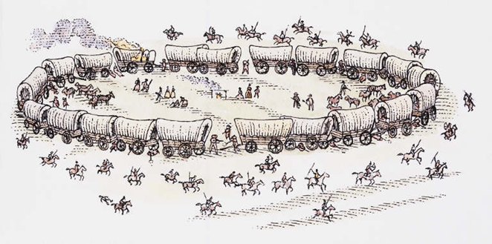
Tactics of Institutional Betrayal
Delay
Denial
Misdirection
Double Bind
Notes:
The failure of organizations to recognize problems and seek a proper remedy has been described as institutional betrayal. When challenged, organizations resort to a series of tactics designed to protect itself from the adverse consequences of its actions: Delay, Denial, Misdirection and the Double Bind. These are designed to project the appearance of accountability but actually function to disrupt due process.
As the Milgram Obedience studies suggests the power of these tactics is magnified when they come at the hands of a would-be esteemed institution.
Of the 4 tactics identified, Delay is notably simple and subtle. It tests the will of the advocate and puts off the moment of reckoning, delaying and sometimes circumventing a solution.

Slide 33

Denial
Ranging from Benign to Malignant
Unconscious Psychological Defense (Freud)
Moral Disbelief
LYING
Notes:
Denial encompasses a broad set of behaviors ranging from the benign to the malignant. According to Freud, unconscious psychological defenses such as denial, are deployed to help cope with the potentially overwhelming emotional impact of distressing events. In time, the defense mechanisms are intended to give way to more effective coping.
Moral disbelief is here defined as a form of denial in which an otherwise ethical person fails to comprehend the reality of a truly terrible wrong, despite compelling evidence. This is poignantly conveyed by legal scholar Raphael Lemkin in his description of the zeitgeist in Berlin during the Holocaust as a twilight between knowing and not knowing.

Slide 34

Mis-Direction
    ETHICS PLACEBOS
    8 Tricks of Language
    22 Cognitive Strategies of justification
    22 Logical Fallacies
“take the place of steps to see, solve, and prevent problems”
Pope (2015)
Notes:
Psychologist Ken Pope describes “ethics placebos” as strategies employed by those who wish to “spin” unethical behaviors into legitimate sounding excuses. These are presented in explicit detail in “Ethics in Psychotherapy and Counseling.”
Understanding complex situations relies on a big picture view and an awareness of context. For this reason, use of ethics placebos rely heavily on the deconstructing of events. Once detached from context, tricks of language, cognitive justifications and logical fallacies are more convincing.

Slide 35
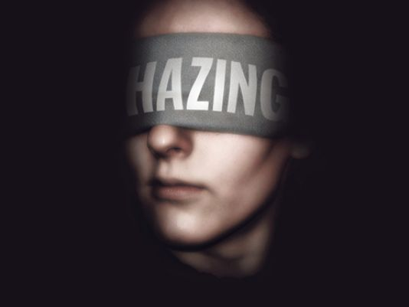
Double Bind
Leave the organization
or
Accept institutional betrayal as a condition of continuing membership
“Lose-Lose” Situation
Illusion of Choice
“Catch 22”
Notes:
The implementation of the double bind is enabled by the power that the organization holds over the individual. It presents a choice is to accept the transgression or leave the organization, neither of which is a proper remedy.
The use of this type of tactics sends a powerful message from the organization not only to victims but to all its constituents. Such actions define the deep culture of the organization and set the standards for expected behavior. The irony lies in the disconnect between the idealistic mission presented as a public face and the true culture.

Slide 36

Sport Culture
Exclusive Membership
Shared Mission
Out Group - In Group Transition
Distinct Language, Clothing, Practices
Notes:
Competitive sport is exclusive by definition, creating an in-group and an out-group in the process of forming a team. Within each new team there are typically established players and newcomers. As the team forms and assimilates its new players, a group dynamic will unfold which can range on a continuum from constructive to destructive.
Given the team’s shared mission and purpose, it is advantageous that this process go well from both a performance and interpersonal perspective.

Slide 37

As a Team Forms…
Group Dynamics Will Unfold
Process
Form… Storm… Norm… Conform…
Shared Mission
Cohesiveness
Performance Enhancement
Danger
“Off the Field of Play”
Activities Not Integral to Sport
Notes:
The phrase “form, storm, norm, conform” captures the process and the challenge of team building. Cohesiveness is likely to pay dividends both on and off the playing field, pointing to the need for a constructive group dynamic.
As team activities move away from matters related to sport and unfold outside the oversight of coaches, the risk of things going awry increases.

Slide 38

Hazing Dilemma
How To Engage In Team Building
In An Era Of Hazing?
  Vagaries of Definition
  Inherent Complexities of Group Dynamics
  Psychological Skills of Those Directing the Process
  Unique Culture of Sport
Notes:
The question of “how to engage in team building in an era of hazing” asked by a coach in a training seminar captures the dilemma faced by athletes, coaches and administrators.
For many reasons, ranging from the complexity of group dynamics to the unique culture of sport, team building can easily slip into hazing.
Given the relative youth of many athletes and the psychological sophistication required to implement team building, it would be prudent to teach team building directly. This proactive step would be a welcome complement to established hazing education which focuses more on what not to do.

Slide 39

Team Building v. Hazing
      POSITIVES
    Constructive Dynamic
    Positive Meaning / Purpose
    Passage
    Bonding
    Measured
  NEGATIVES
        Destructive Dynamic
        No True Meaning / Purpose
        Persisting
        Divisive
        Harsh
Notes:
Most simply put, team building is a positive experience and hazing is negative. There are a series of contrasting psychological dynamics that differentiate team building and hazing. However, in practice making this distinction can be difficult. That said, the very same activities could be positive or negative depending upon the subtleties of the way the experience unfolds, and the ability of those directing the process to implement proper checks and balances.
Take a scavenger hunt for example. While identified as a hazing practice, arguably it can be done without a dangerous or demeaning impact. Which raises the question, if it is not destructive or demeaning, is it hazing?
This reinforces the value of approaching team building in a proactive way, with a particular positive purpose, and mindful of group dynamics.

Slide 40
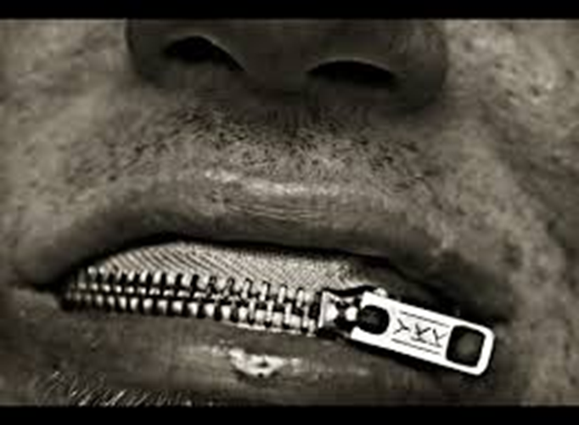
Signs of Hazing
Individual Dynamic
        Fear
        Mistrust
Team Dynamic
        Secrecy
        Minimization
Organization
        Evasiveness
        or
        Accountability
Notes:
Hazing activities may range from relatively benign to outright destructive. When clearly destructive, there are typical signs that can be identified at the individual, team and organizational levels. These are usually subtle and not easily detected.
When those in a leadership role understand the dynamics of hazing, cultivate a culture of trust, embrace accountability, and strive to remain alert and aware of outlier behaviors, the chances for detection are greatly enhanced. Hazing thrives in the dark and is transformed in the light.

Slide 41

Assessing Hazing
ACTION -- What was Done
Forced alcohol use; Unwanted sexual behavior; Physical brutality; Forced cross-dressing; Property destruction; Social exclusion; Scavenger hunt.
INTENTION - Underlying Dynamics
Outright Punitive, Dangerous, Illegal?; Good intention-Poor results? Reflecting immaturity or unintended consequences? Team buy-in or Personal agenda?
IMPACT - Personal Experience
Psychologically demeaned; Physically Injured; Sport performance or academics undermined? Relationships enhanced or harmed?
Notes:
Differentiating hazing and team building requires a multidimensional approach which considers action, intention and consequence. Identifying hazing categorically as a set of specific actions has inherent limitations. As noted previously, whether a given set of behaviors is or is not hazing has a great deal to do with the underlying attitudes and intentions of those directing the process. An understanding of the underlying attitudes and intentions enables effective intervention in hazing, and serves as the pivot point in shifting from hazing to proper team building.
While the impact of a group activity defines the severity of hazing, the roots of risk lie in the intentions of those directing the practice, a common sense understanding of danger, and a readiness to modify or stop the activities if they appear to be demeaning or damaging. When directed by those who are consuming alcohol and drugs, sensible decision making is compromised and a layer of danger is added.
Context is also an important factor. Consider military school training practices, which may appear to be harsh, and may in fact be harsh by design. The underlying objective and intentions may be sensible within the overarching context of military service. When such practices are in place, they are typically directed by those who are specifically trained and qualified to do so and who operate within the oversight of a command structure. This stands in contrast to how hazing typically operates -- without special training and expertise, and without oversight.

Slide 42

Talking About Hazing
DISCUSS
        ACTION - What ?
        Mesh point on Maslow’s Hierarchy?
        INTENTION – Why?
        Goal/Expected Outcome
        IMPACT – on Players & Team
        Team dynamic enhanced or undermined?
        ASK
        Is there a better way?
Notes:
An honest and open dialogue is the start to transforming hazing into team building. This may be done proactively or in reaction to an incident.
When the conversation follows an incident, it may be useful to begin with a look at the impact: “Was it helpful or not?” and “If not, then why not?” This provides a segue to examining underlying intentions and expectations, and the extent to which the specific actions taken did or did not yield a desirable outcome.
While it is important for those in a leadership role set boundaries, point out pitfalls and implement a remedy, it is essential this be done in a constructive manner, with reasonable tolerance for error, and with reframing of mistakes as an opportunity for learning.

Slide 43
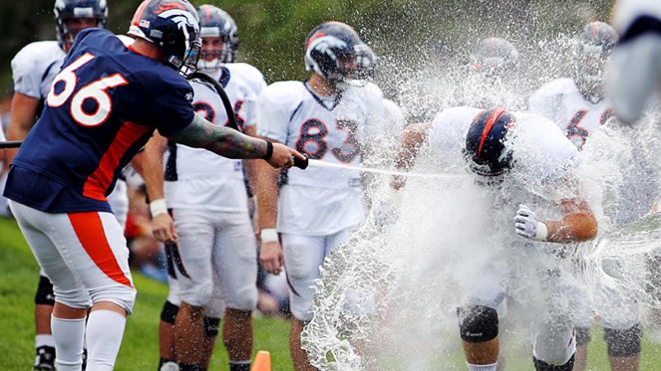
Rethinking Hazing
HAZING REFRAME
“If it is not OK to do in other environments – the Classroom, The Boardroom, the Living Room -
then WHY is it OK in sport?”
A “Different” Standard in Sport ?
Notes:
While good intensions may result in a bad outcome, this is far more likely when those involved act as if activities within a sport team operate by a different set of rules than in other group settings in society. If an activity would not stand scrutiny in these other settings, then it is probably not helpful in sport.

Slide 44

Teach Team Building
        Design Activities as Group Exercise
          RISK Minimized
              Leeway To Explore
              Team Building May Lead To Mistakes
              BENEFIT Enhanced
              Learning Opportunity
              Lesson For Life After Sport
              LEADERS Developed
Notes:
Identifying a cause-effect relationship between a given group activity and improved team dynamics is the starting point for defining and teaching team building.
Team building is a complex and challenging activity in the best of circumstances, requiring expertise and a well-developed plan. Leaving this to the devices of the team without supervision and guidance is no more effective than allowing the team to train without coaching or sending the team on the playing field without developing a game plan.

Slide 45

ADVOCACY: Taking Action
        WHY?
        WHAT?
        WHO?
Notes:
The reason for Advocacy lies in answer to the questions: Why take action advocate? What is the goal? Who should act?

Slide 46

WHY: Sport as Social Institution
Reflection of Society
Model for Society
Sport as Lens on
Social Issues
&
Agent of Change
Notes:
Why take action?
At a societal level the reach of sport is extraordinary, with a demonstrated history in social change. Sport is a powerful social institution, prominent in the public eye, reflecting society, providing a forum to examine behavior, setting cultural standards and serving as a force for change.
HIV positive NBA star, Magic Johnson’s status as a well-respected athlete combined with his ability to bring a popular face and a positive attitude to the disease, changed the conversation and created a sense of hope and acceptance.
Reflecting on the impact of both grassroots sports and a South African Rugby World Cup victory in the transition from apartheid, Nelson Mandela suggests: “Sport can create hope where once there was only despair. It is more powerful than governments in breaking down barriers. Sport has the power to change the world.”

Slide 47

WHAT: Sport’s “END GAME”
Better Society
&
Better People
Notes:
The “up” side to sport done well is remarkable, with roots that reach deep into the history. Sport is a cornerstone of Western Civilization.
Ancient Greek culture gave the world the Olympic Games, a bloodless celebration of warrior skills that is the foundation of modern sport. In the legend of Pheidippides and his Marathon run, there is a view of heroism that champions honor and service in a higher cause. With Greek theatre as a reference point, Aristotle speaks to the transformative power of challenge and trial when played out in a public spectacle. His references to character and catharsis translate well to participant and spectator in contemporary sport.
Keeping sight of the best of what sport can be helps define the mission and illuminate the path to a better society.

Slide 48
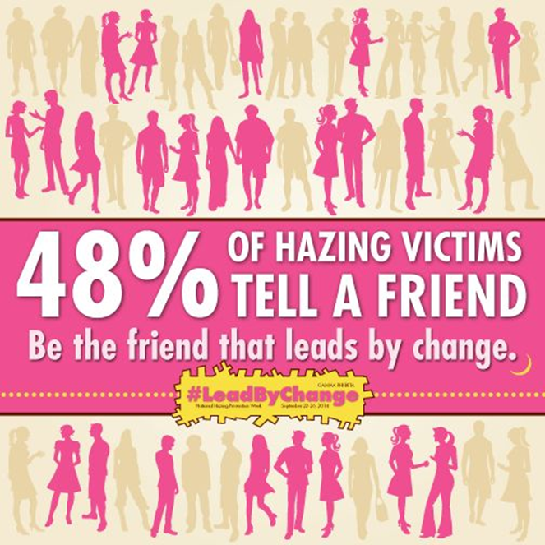

WHO: The “POWER OF ONE”
Milgram Study
Experimenter offers permission
Stanford Prison Experiment
Dr. Maslach protests
Dodger Team Captain, Pee Wee Reese, stands with Jackie Robinson
A Turning Point in Baseball
Notes:
The “Who” is you – any and all sport stakeholders who want sport to be a positive force in society.
While many my try without success, the power of one to make change has been proven again and again. This was seen in the Milgram and Stanford experiments, and in the courage of Magic Johnson. It is also seen in the moment that Brooklyn Dodger captain, Pee Wee Reese stood by Jackie Robinson on the playing field, in what has been described as a tipping point in the racial integration of professional sport.

Slide 49

Athlete Ethos: The True Group Dynamic
Heroes of 9/11
Beamer–Burnett–Bingham–Glick
United Flight 93
Defining Moment: Athlete “End Game”
Athlete Ethos
            Identify Challenge
            Work as a Team
            Think Pragmatically
            Convert Idea to Action
            Act with Courage & Composure
Notes:
Military commander (and later British Prime Minister), the Duke of Wellington, suggests that the famous Battle of Waterloo was won on the playing fields of Eton, a school where many of the military officers of the day were educated.
Much the same may be said regarding the role of sport in the start of the fight back on 9/11. The names, Beamer, Burnett, Bingham and Glick are not well known although perhaps they should be. These former college athletes teamed up to assault the hijackers of Flight 93, saving lives while hastening their own deaths. They showcased the skills honed through sport: to identify a challenge, work as a team, think pragmatically, convert idea to action, and act with courage and composure.
Not all will be champions, but every athlete can grow in this same skill set and in so doing leave sport enriched and better prepared for life after. This positive model of the games we play and the skills we build speak to the value of sport.
A simple measure of any team building practice is in answer to the question: "Is the sport experience preparing athletes to be more or less likely to rise to this type of challenge?"

Slide 50
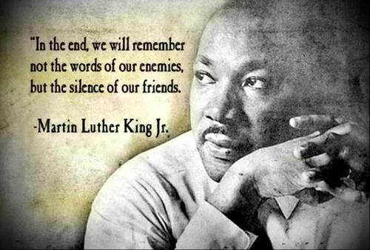
Resources
Sport Hazing http://www.commonwealthgames.org/sport-hazing
Stop Hazing
https://www.stophazing.org/
Step Up!
http://stepupprogram.org/hazing
Safe Sport
https://safesport.org/
NCAA – “Mind, Body & Sport” http://www.ncaa.org/sport-science-institute/introduction-mind-body-and-sport
Notes:
A brief listing of resources is provided.
All are encouraged to examine the Sport Hazing website (http://www.commonwealthgames.org/sport-hazing) to continue to develop awareness and to prepares for action.
Funded and developed by the American Psychological Association (APA) and the Society for Sport, Exercise & Performance Psychology. Programmatic support provided by APA Division of School Psychology, APA Society for the Psychological Study of Social Issues, the International Swim Coaches Association, Virginia Amateur Sports, and Swim Sport Psychology.

